Slide 1
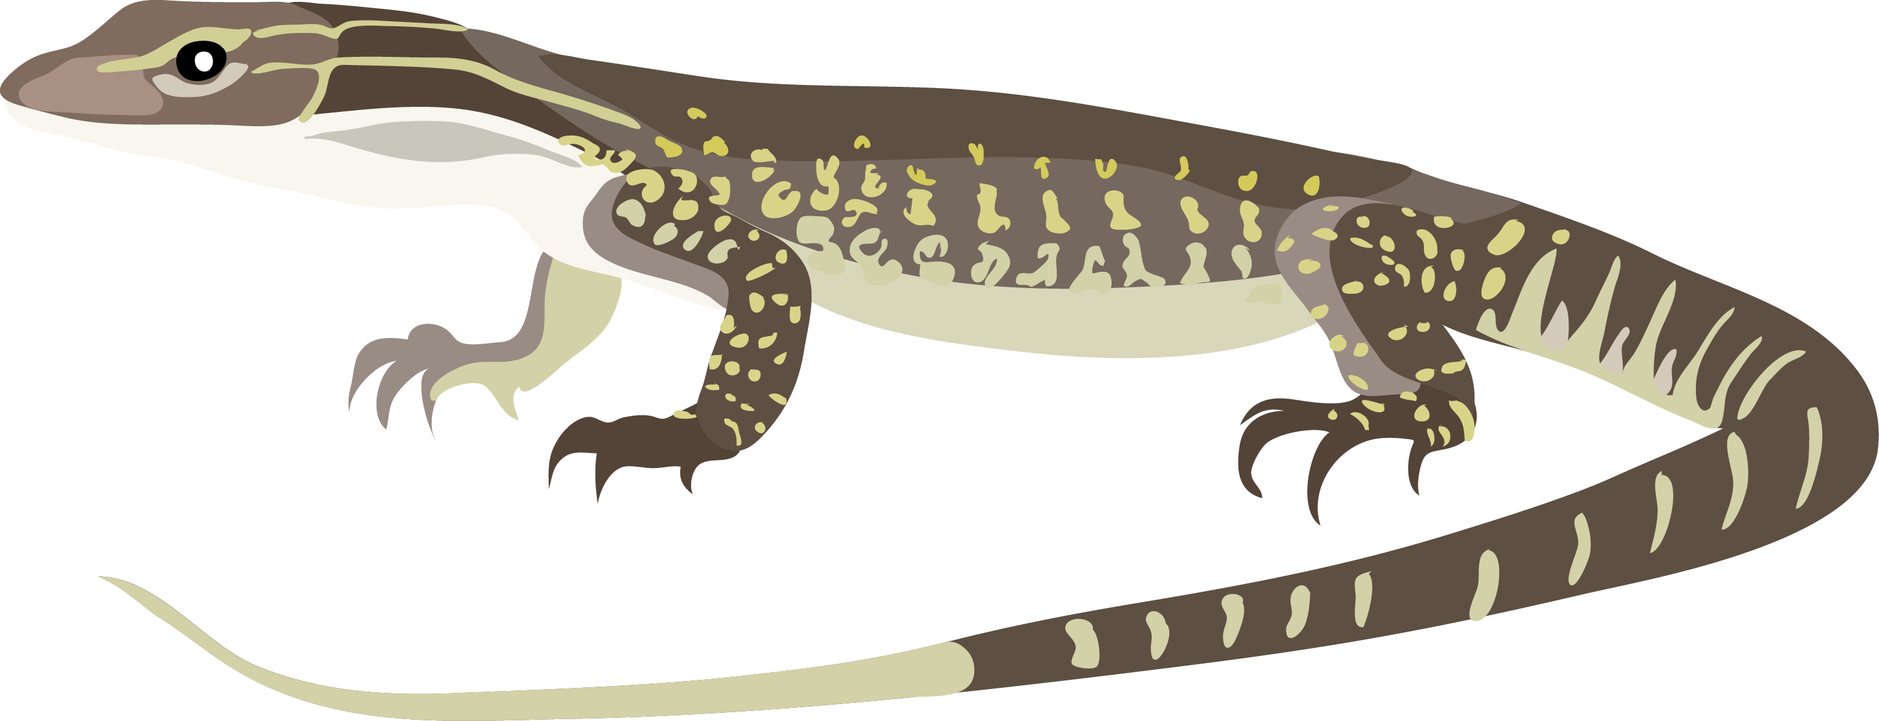
MAKING BETTER FIGURES
WITH ILLUSTRATOR
www.github.com/IanGBrennan/Presentation_Skills

Slide 2
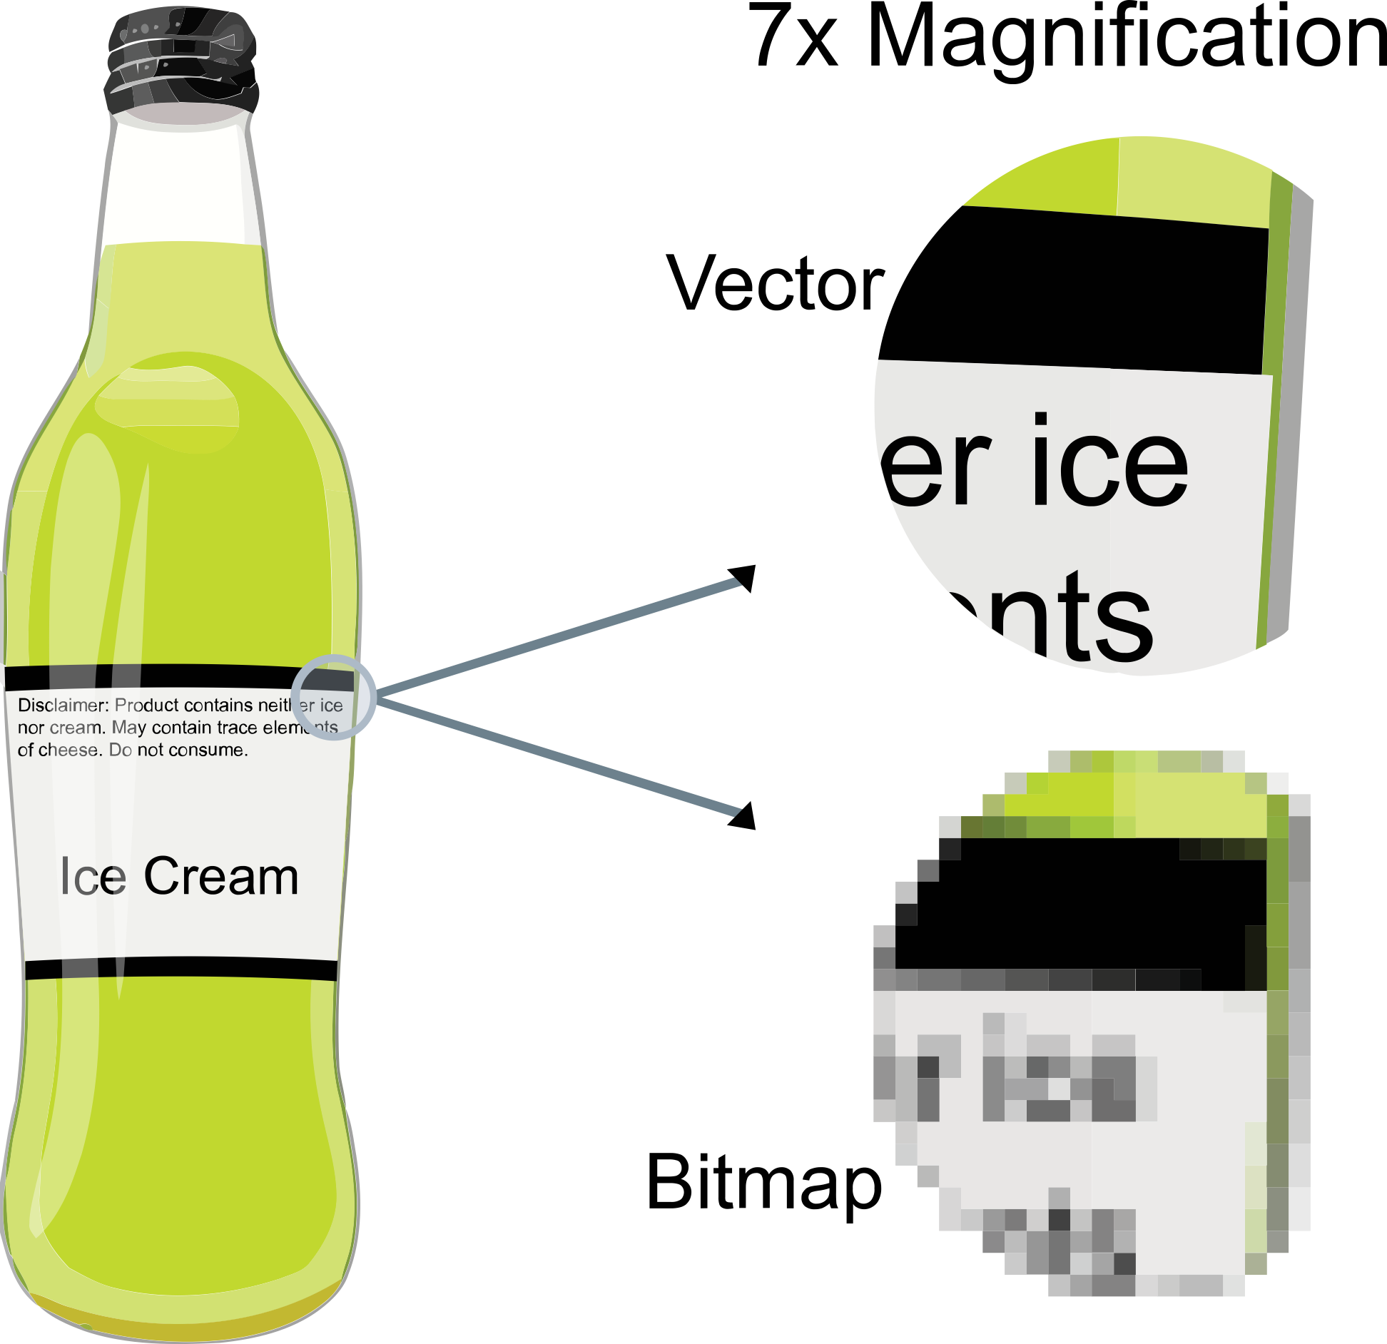
VECTORIZED IMAGES
COMMON VECTORS: .PDF, .SVG, .EPS
COMMON RASTERS:
.JPG, .PNG, .GIF

Slide 3
OPEN:
Komodo_Dragon.png Komodo_Dragon.pdf

Slide 4
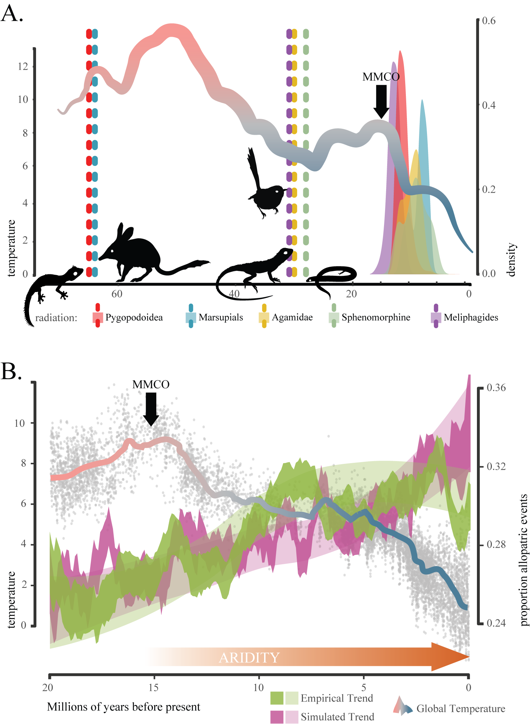
WHAT’S WRONG HERE?
CAN WE SIMPLIFY THE FIGURE?
WHAT DO WE KEEP?
WHAT HAS TO GO?

Slide 6
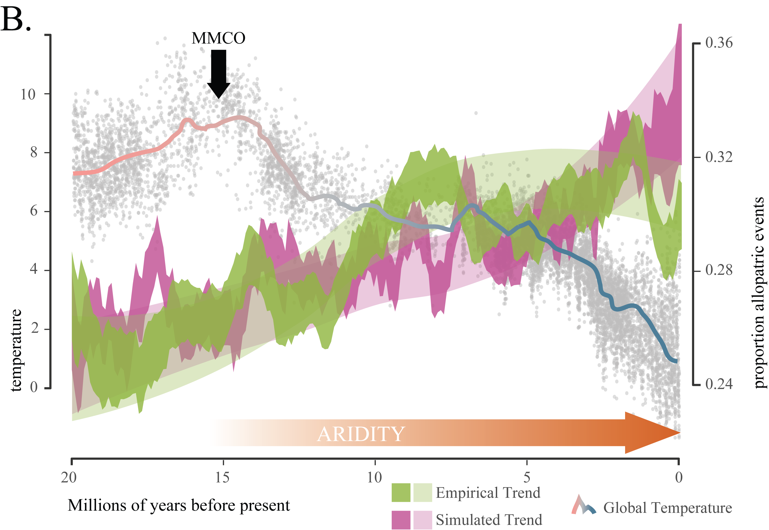

Slide 8
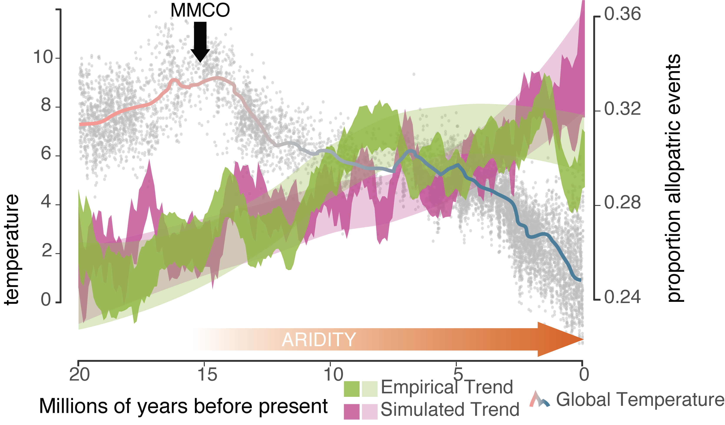

Slide 10
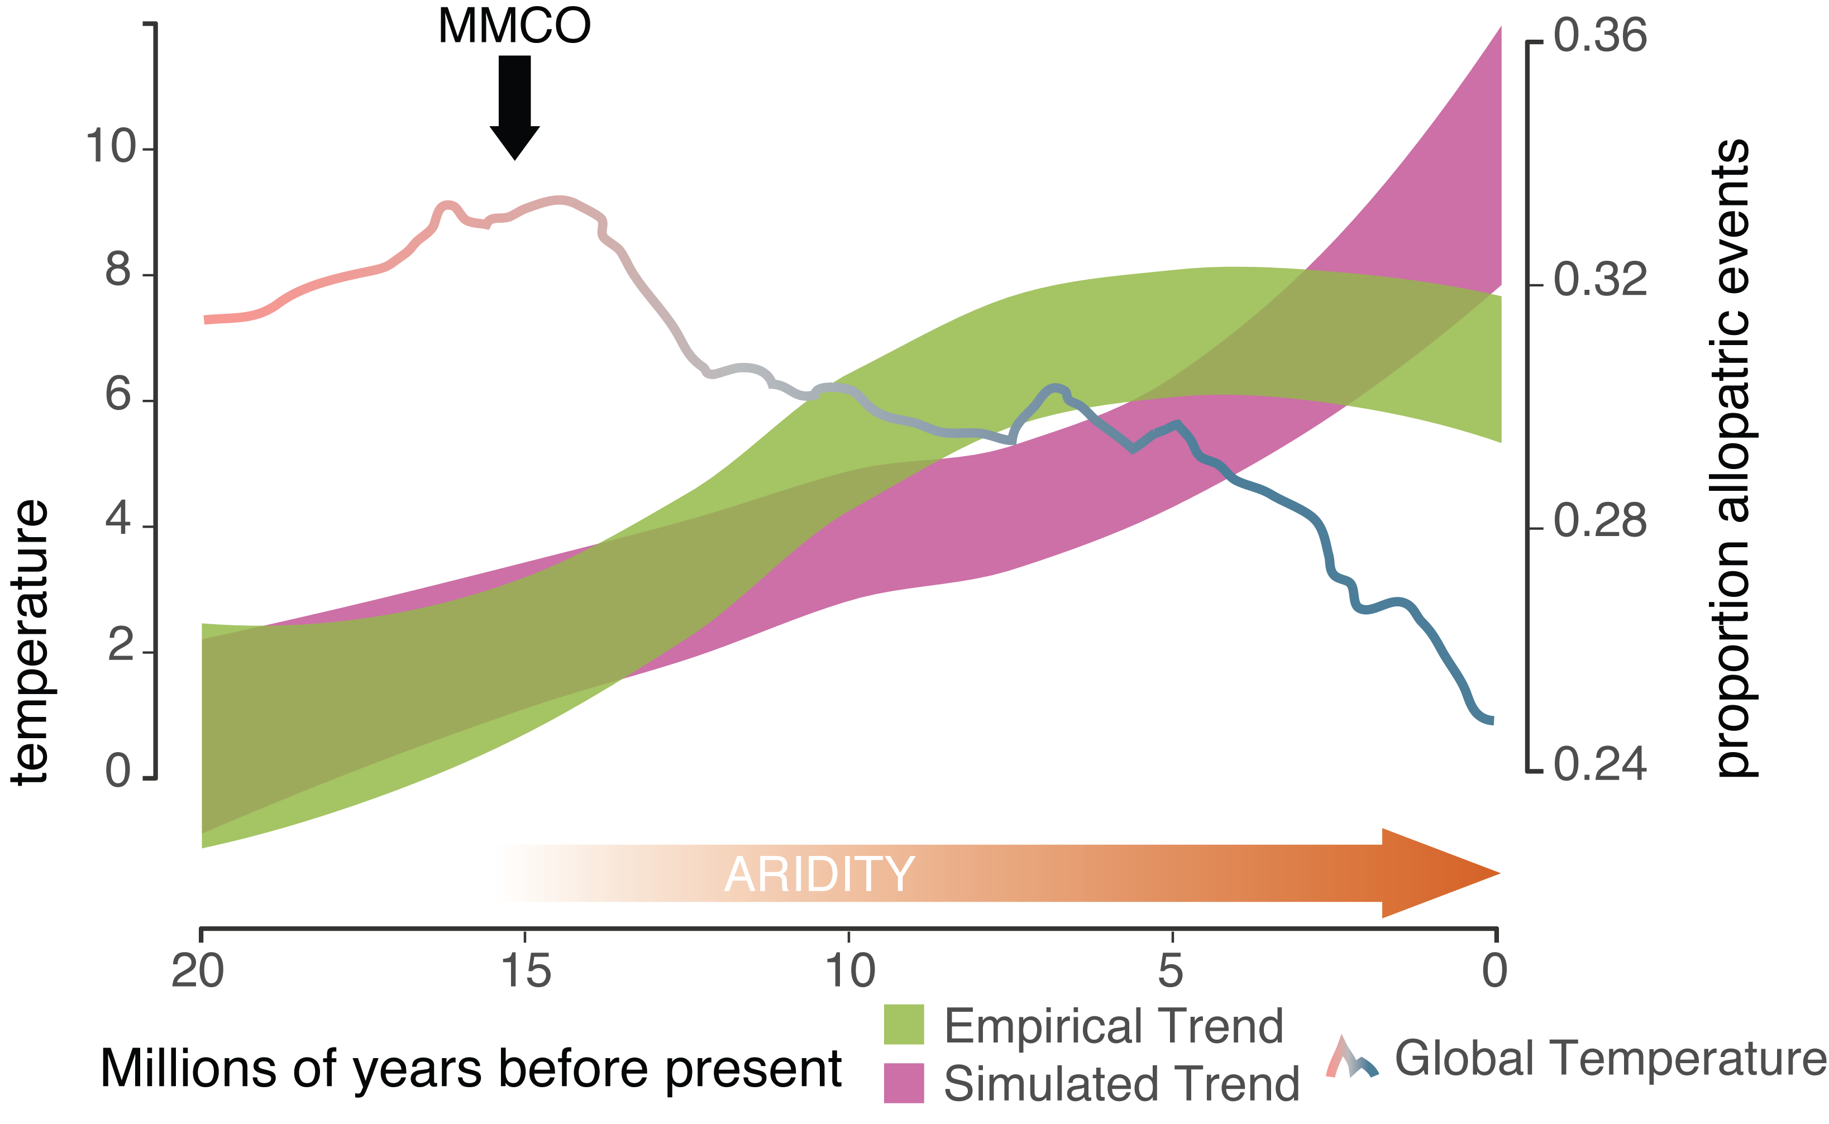

Slide 12
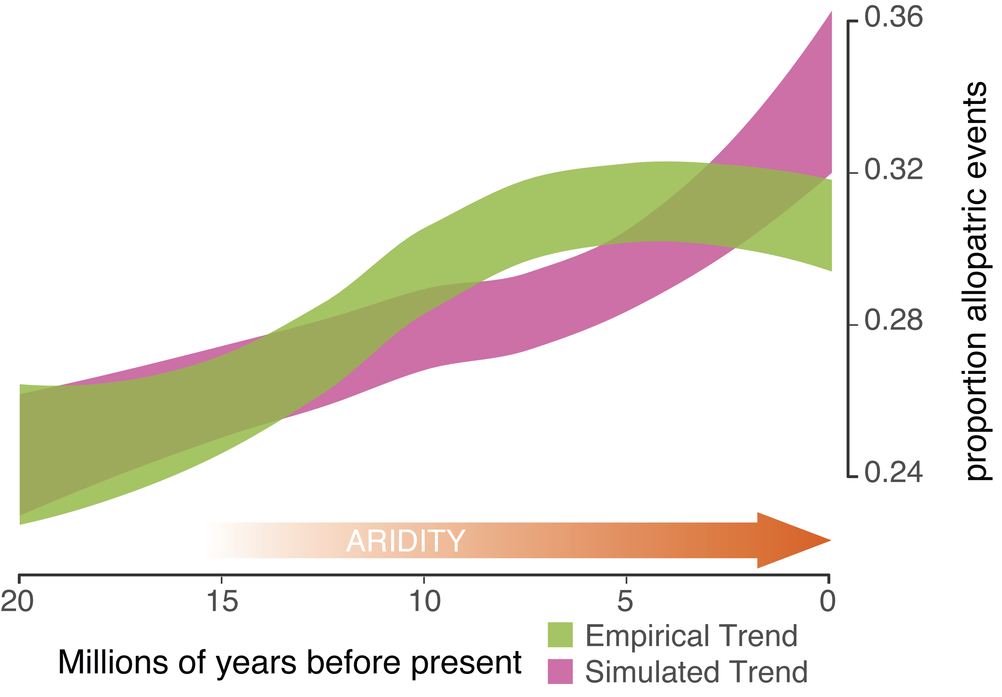

Slide 14
ALLOPATRY INCREASES THROUGH TIME
BEYOND WHAT WE EXPECT

Slide 15

LET’S TRY OUR OWN, OPEN:
Iris_Plot.R (or) Iris_Plot.pdf

